Slide 1
JC Wechat Community Quiz Design
Nov, 2016
Notes:
1

Slide 2
URL & GA JS
URL：
http://jc.pernod-ricard-china.com/sha-jc-quiz/
GA JS：
<script>
(function(i,s,o,g,r,a,m){i['GoogleAnalyticsObject']=r;i[r]=i[r]||function(){
(i[r].q=i[r].q||[]).push(arguments)},i[r].l=1*new Date();a=s.createElement(o),
m=s.getElementsByTagName(o)[0];a.async=1;a.src=g;m.parentNode.insertBefore(a,m)
})(window,document,'script','https://www.google-analytics.com/analytics.js','ga');
ga('create', 'UA-64679472-3', 'auto');
ga('send', 'pageview');
</script>

Slide 3
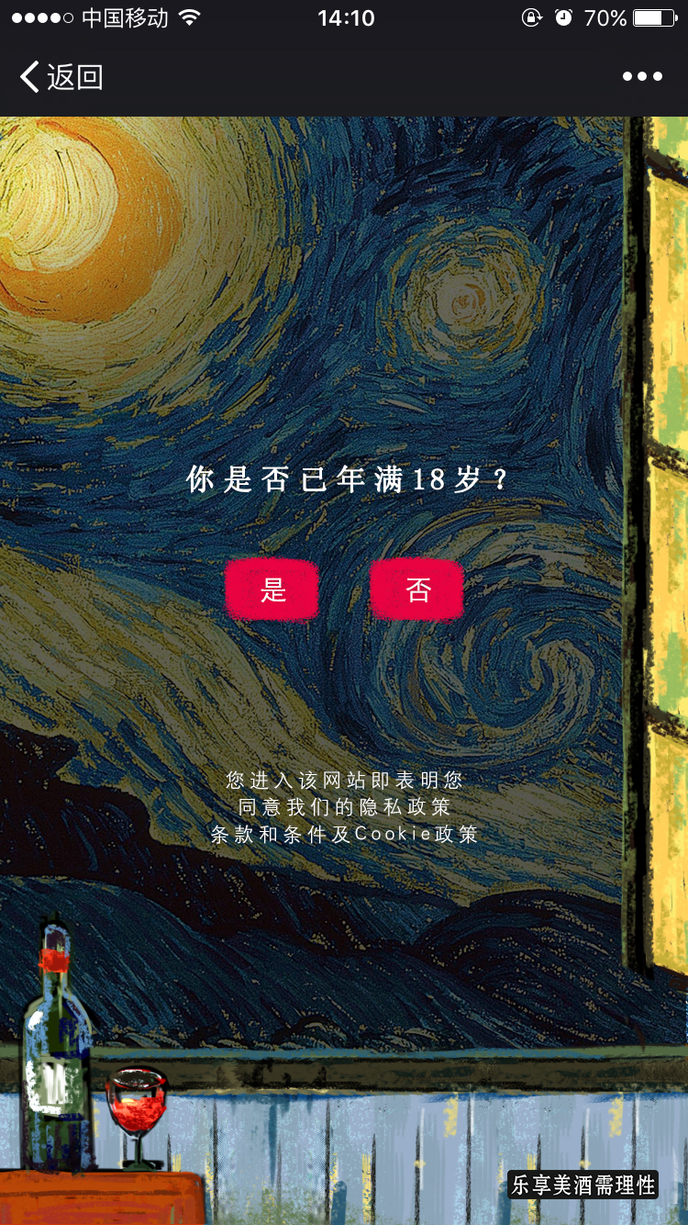
Age gate
# | Event Category | Event Name
1 | Community Quiz | Age_gate_YES
2 | Community Quiz | Age_gate_NO
1
2

Slide 4
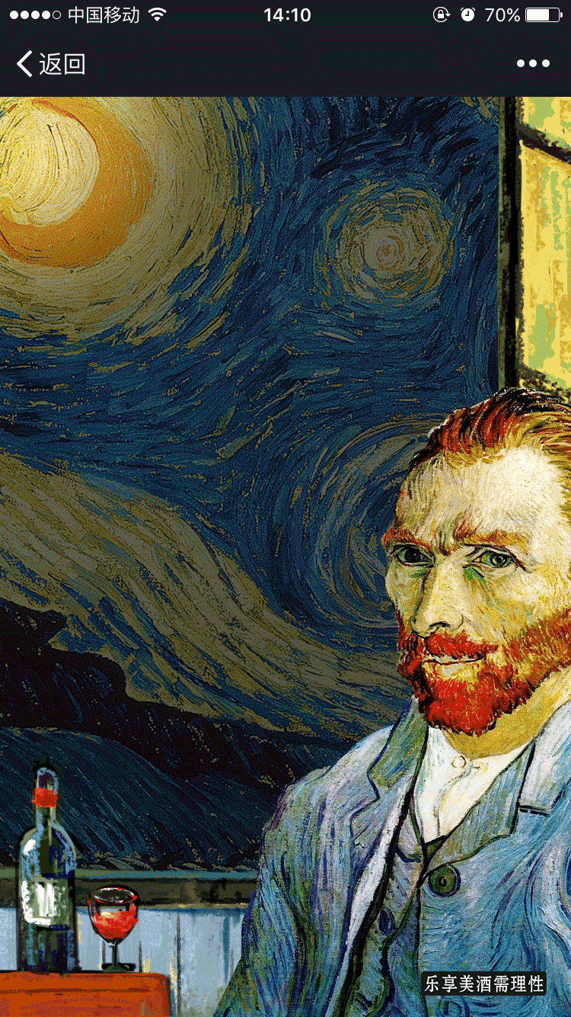
Start

Slide 5
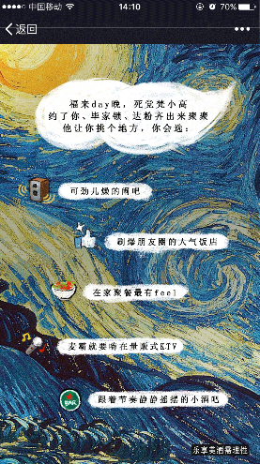
Q1
# | Event Category | Event Name
1 | Community Quiz | Q1_1
2 | Community Quiz | Q1_2
3 | Community Quiz | Q1_3
4 | Community Quiz | Q1_4
5 | Community Quiz | Q1_5
1
2
3
4
5

Slide 6
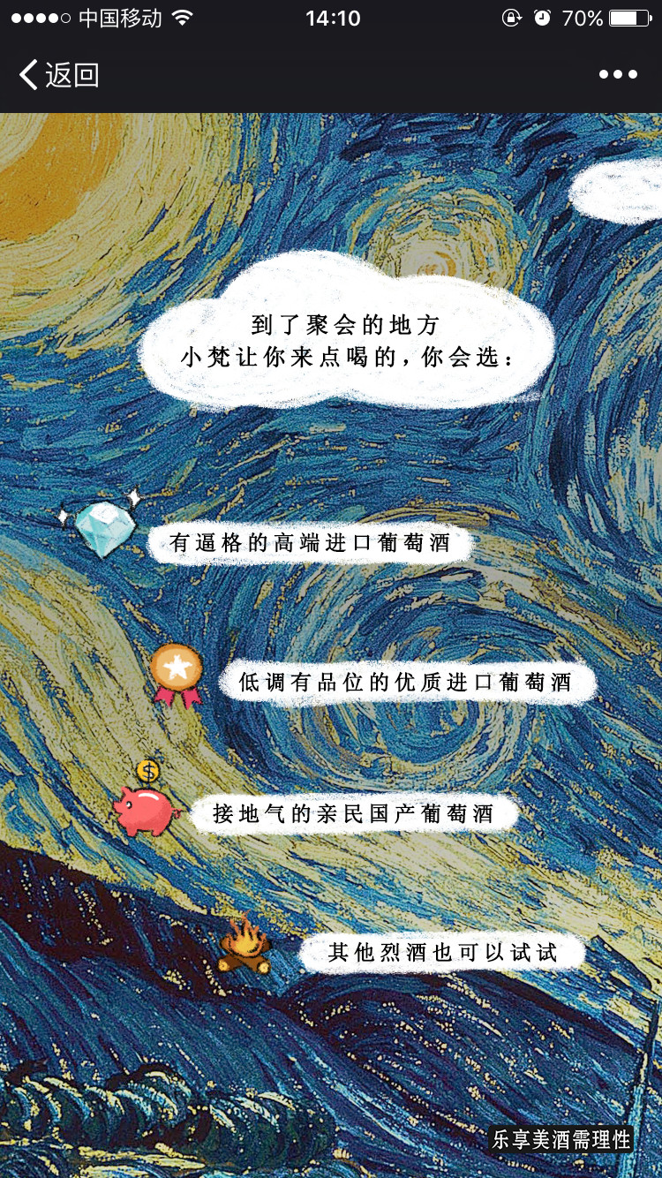
Q2
# | Event Category | Event Name
1 | Community Quiz | Q2_1
2 | Community Quiz | Q2_2
3 | Community Quiz | Q2_3
4 | Community Quiz | Q2_4
1
2
3
4

Slide 7
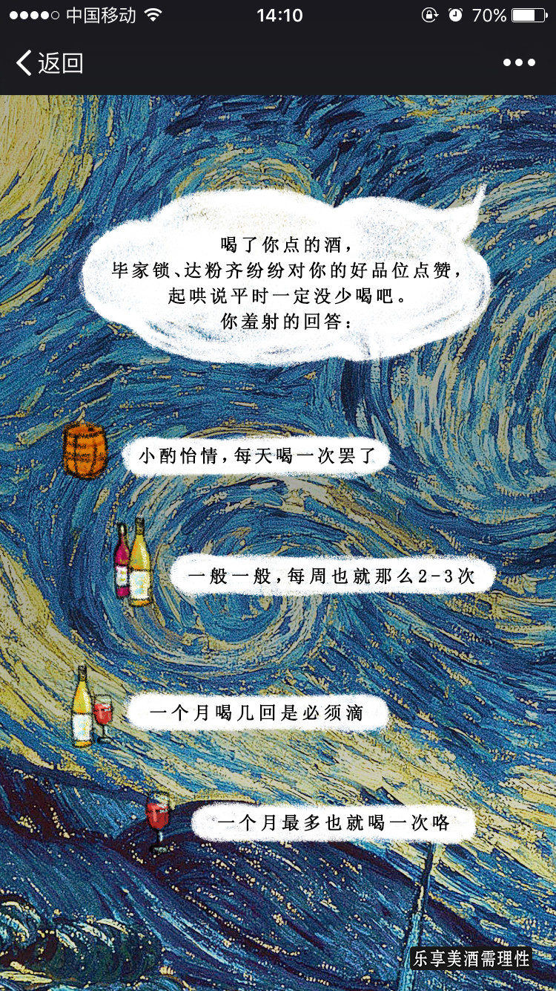
Q3
# | Event Category | Event Name
1 | Community Quiz | Q3_1
2 | Community Quiz | Q3_2
3 | Community Quiz | Q3_3
4 | Community Quiz | Q3_4
1
2
3
4

Slide 8
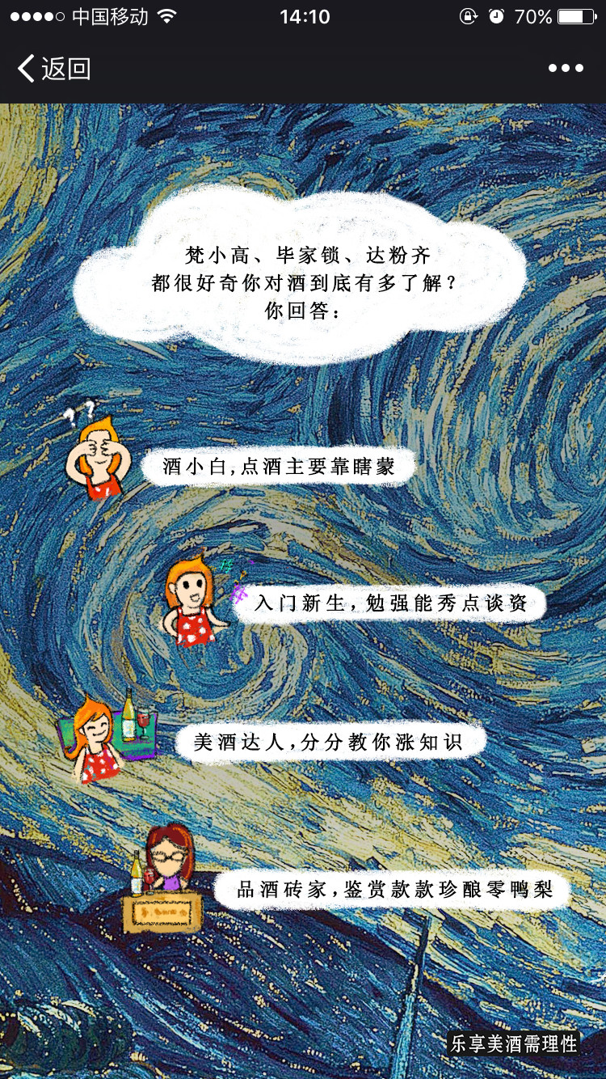
Q4
# | Event Category | Event Name
1 | Community Quiz | Q4_1
2 | Community Quiz | Q4_2
3 | Community Quiz | Q4_3
4 | Community Quiz | Q4_4
1
2
3
4

Slide 9
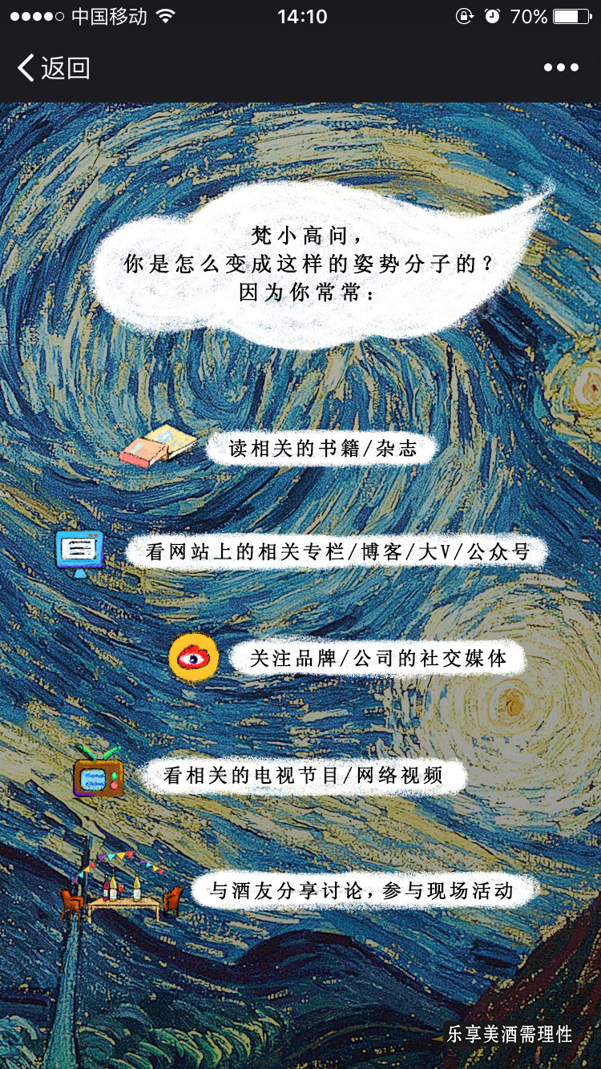
Q5
# | Event Category | Event Name
1 | Community Quiz | Q5_1
2 | Community Quiz | Q5_2
3 | Community Quiz | Q5_3
4 | Community Quiz | Q5_4
5 | Community Quiz | Q5_5
1
2
3
4
5

Slide 10
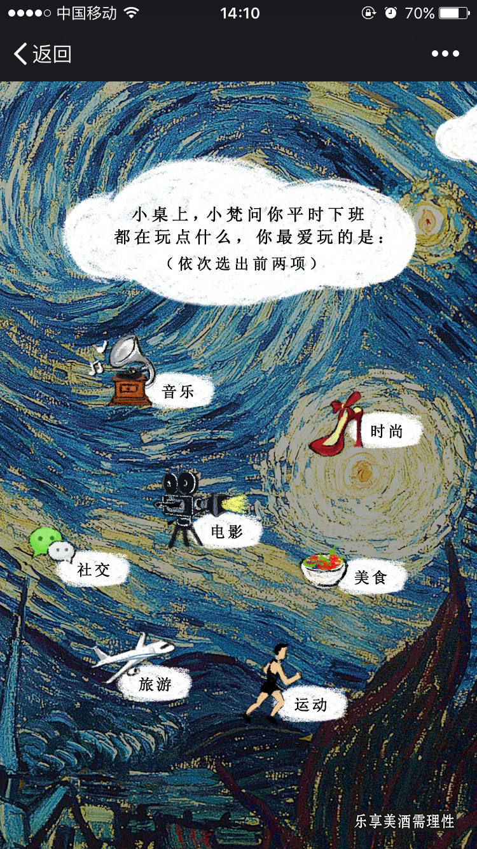
Q6
# | Event Category | Event Name
1 | Community Quiz | Q6_1
2 | Community Quiz | Q6_2
3 | Community Quiz | Q6_3
4 | Community Quiz | Q6_4
5 | Community Quiz | Q6_5
6 | Community Quiz | Q6_6
7 | Community Quiz | Q6_7
1
2
4
3
5
6
7

Slide 11
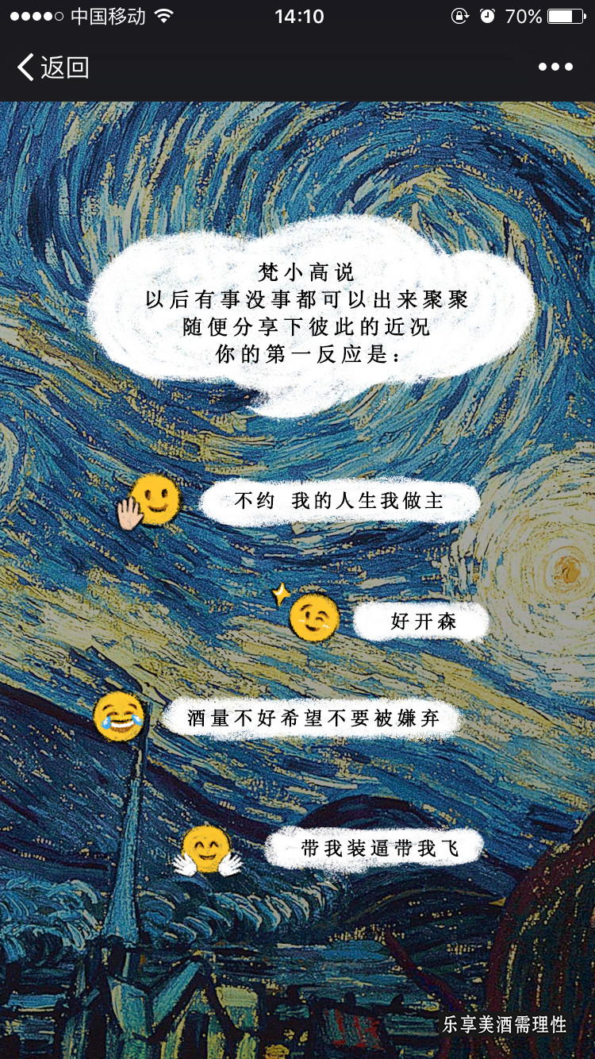
Q7
# | Event Category | Event Name
1 | Community Quiz | Q7_1
2 | Community Quiz | Q7_2
3 | Community Quiz | Q7_3
4 | Community Quiz | Q7_4
1
2
3
4

Slide 12
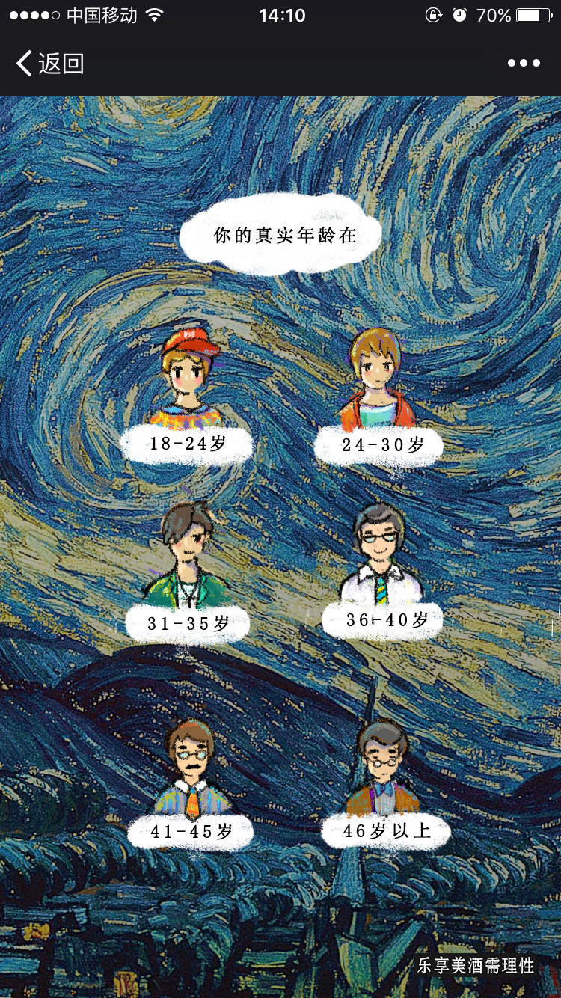
Q8-男
# | Event Category | Event Name
1 | Community Quiz | Q8_1
2 | Community Quiz | Q8_2
3 | Community Quiz | Q8_3
4 | Community Quiz | Q8_4
5 | Community Quiz | Q8_5
6 | Community Quiz | Q8_6
1
2
3
4
5
6

Slide 13
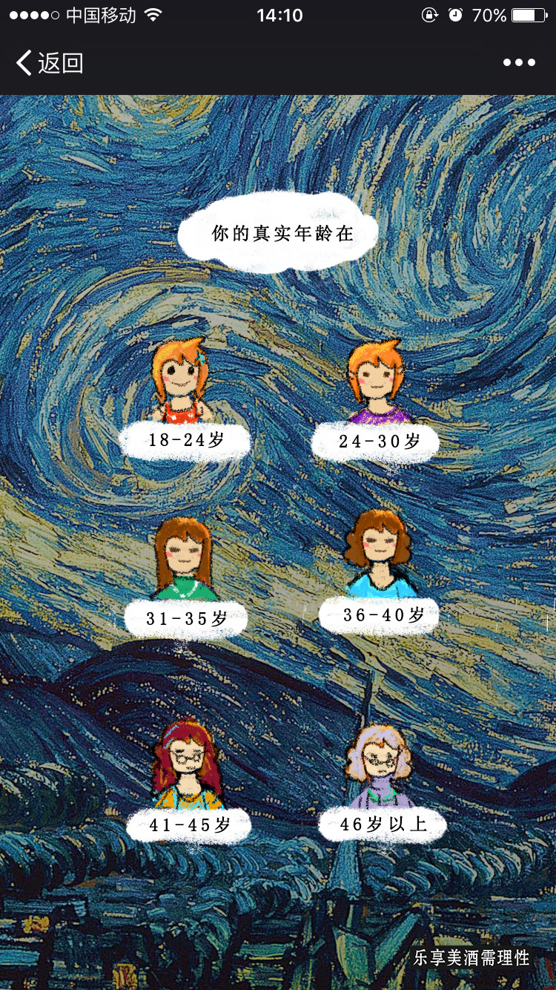
Q8-女
# | Event Category | Event Name
1 | Community Quiz | Q9_1
2 | Community Quiz | Q9_2
3 | Community Quiz | Q9_3
4 | Community Quiz | Q9_4
5 | Community Quiz | Q9_5
6 | Community Quiz | Q9_6
1
2
3
4
5
6

Slide 14
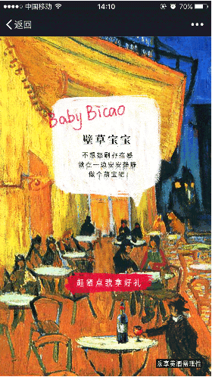
Result1
# | Event Category | Event Name
1 | Community Quiz | Baby_Bicao
1

Slide 15

Result2
# | Event Category | Event Name
1 | Community Quiz | Warm_up
1

Slide 16
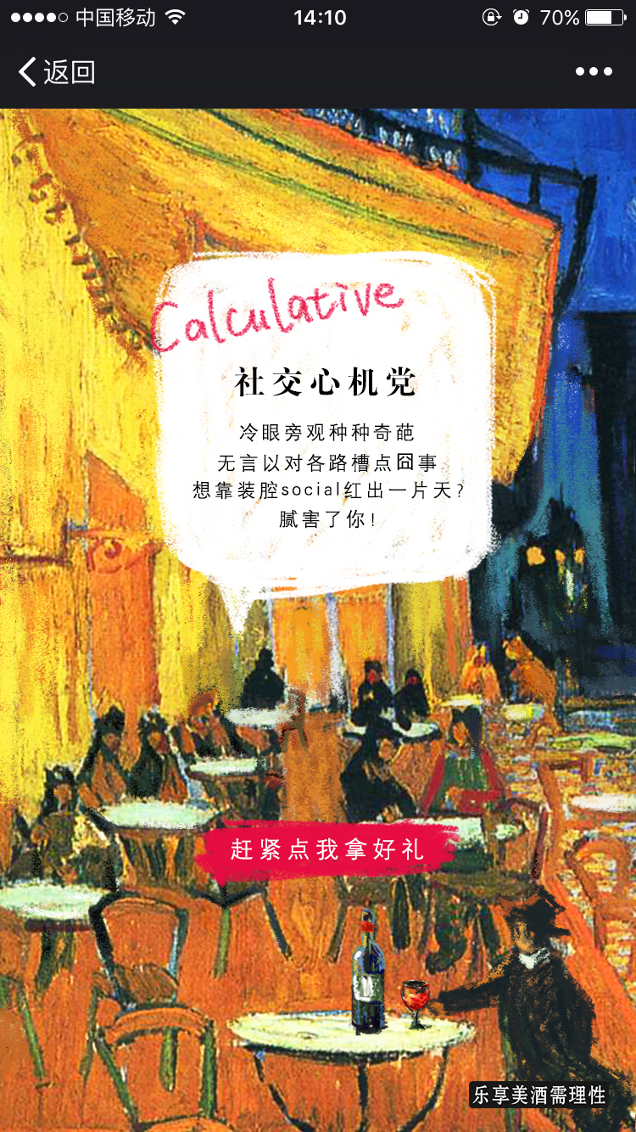
Result3
# | Event Category | Event Name
1 | Community Quiz | Calculative
1

Slide 17

Result4
# | Event Category | Event Name
1 | Community Quiz | Topic_Maker
1

Slide 18
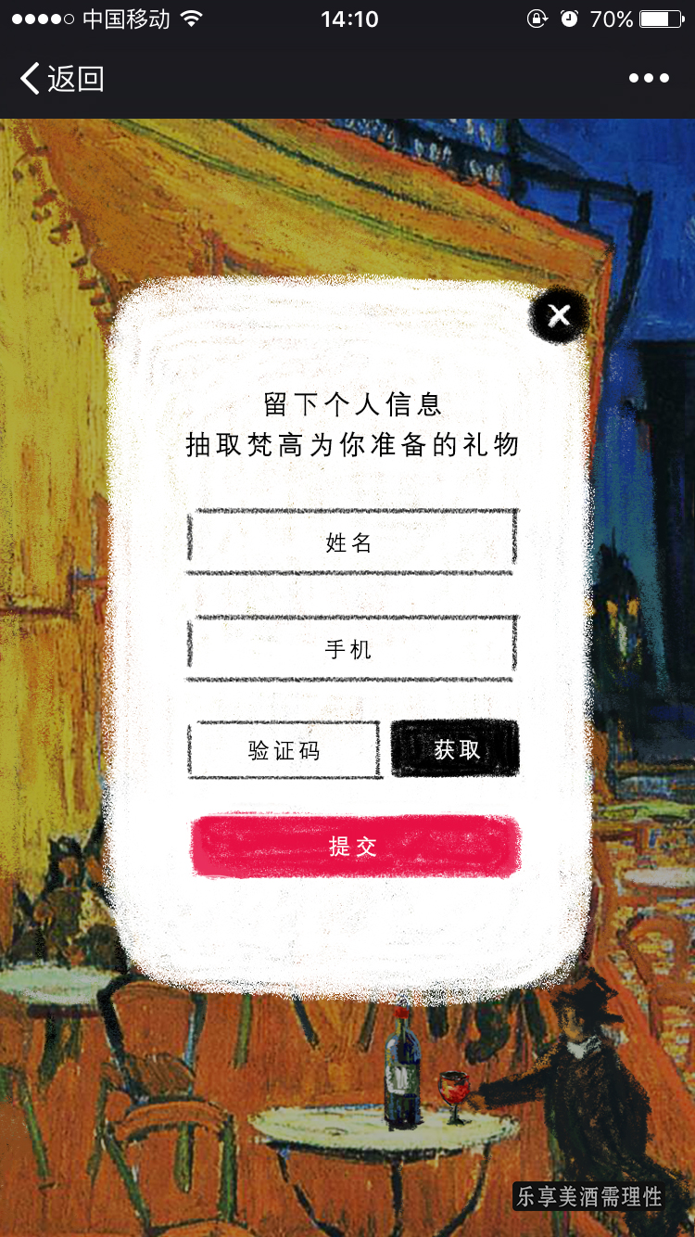
Leave information
# | Event Category | Event Name
1 | Community Quiz | Verify_PN
2 | Community Quiz | Submit_PN
1
2

Slide 19
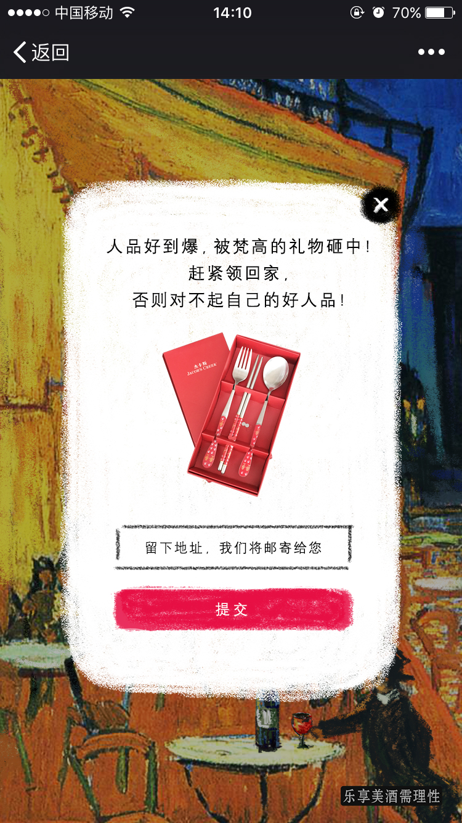
Get present-leave address
# | Event Category | Event Name
1 | Community Quiz | Win_Submit_Adress
1

Slide 20
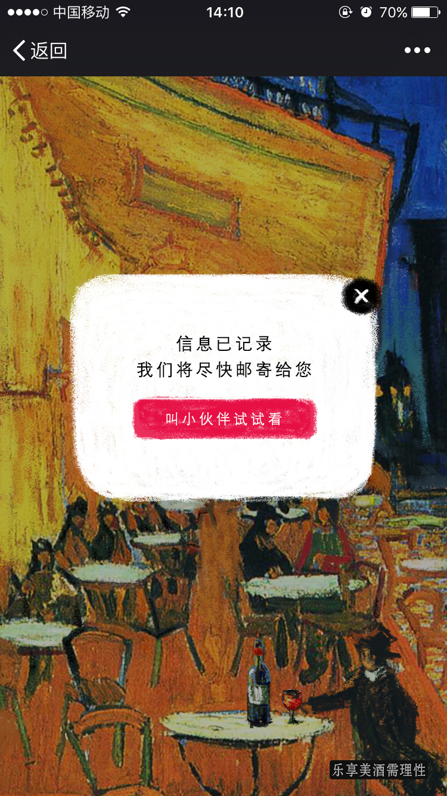
Get present
# | Event Category | Event Name
1 | Community Quiz | Win_Share
1

Slide 21

Get no present
# | Event Category | Event Name
1 | Community Quiz | Fail_Share
1

Slide 22
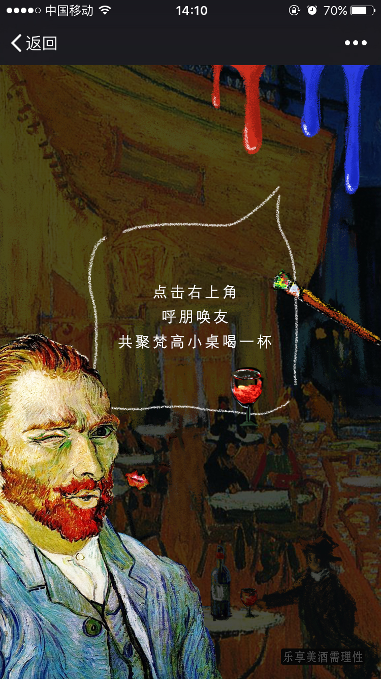
Share
1
# | Event Category | Event Name
1 | Community Quiz | Share
请技术加Share Tracking

Slide 23
THANK YOU

